Slide 1


Slide 2
What is Jira?
Jira is a proprietary issue tracking product developed by Atlassian that allows bug tracking and agile project management.
JIRA is a software testing tool developed by the Australian Company Atlassian. It is a bug tracking tool that reports all the issues related to your software or mobile apps. The word JIRA comes from the Japanese word, i.e., "Gojira" which means Godzilla.
JIRA is based on the Agile methodology and the current version of the Jira is 6.

Slide 3
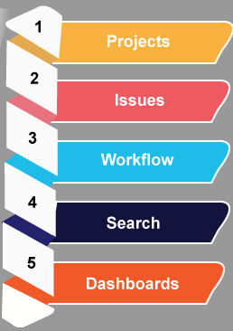
The following are the useful aspects provided by the Jira:
Projects: It is used to manage the defects very effectively.
Issue: It is used to track and manage the defects/issues.
Workflow: Processes the Issue/Defect life cycle. Suppose we have a business requirement, we create the technical design and from the technical design, we create the test cases.
Search: Find with ease. Suppose we have done with a project at the beginning of the December and its version is 1.0. Now, we move to version 1.1 and completed at the end of December.
Dashboards: Dashboard is a display which you see when you log in to the Jira. You can create multiple dashboards for multiple projects.

Slide 4
Why Jira?
JIRA tool is used because of the following reasons:
Plan, Track and Work Faster
The main source of information
Organize the documentation tasks
Track the progress of our documentation
Helps to meet the deadlines of a documentation release.
Measures the time spent on documentation
Provides feedback faster

Slide 5
What all can be done using JIRA?
Jira helps teams plan, assign, track, report, and manage work and brings teams together for everything from agile software development and customer support to start-ups and enterprises.

Slide 6
What is an Issue?
Issue Types in Jira are:
JIRA Issue is used to track the individual pieces of work that has been completed or not. JIRA issue can be a software bug or any other issue. Once you have imported the project in Jira, you can create issues.
Story
Task
Bug
Subtask
Epic

Slide 7
JIRA Core Default Issue types
Task: The task is a work item done by the team but not connected directly to the user's requirements. For example, to upgrade the version of a product used by the teams.
Subtask: It is a part of another issue. It is used to break an issue into different pieces of work. While creating an issue, sub task issue is not given in the issue type field drop-down as it contains some parent issue, so we can say that subtask issue cannot be created independently.

Slide 8
JIRA Software default issue types
Story: It is a requirement from the user's perspective.
Bug: It is a flaw in a product that needs to be fixed by the developers. It can be tracked with its own issue type to differentiate from other types of work.
Epic: An epic is a big issue that contains other issues.

Slide 9
JIRA Service desk default issue types
Incident
Service Request
Change
Problem

Slide 10
JIRA Bug Life Cycle
JIRA bug life cycle is also known as a defect life cycle. The bug life cycle consists of a set of states that a bug goes through. The number of states that the bug goes through varies from project to project.
New
Assigned
Open
Fixed
Retesting
Reopen
Verified
Closed

Slide 11
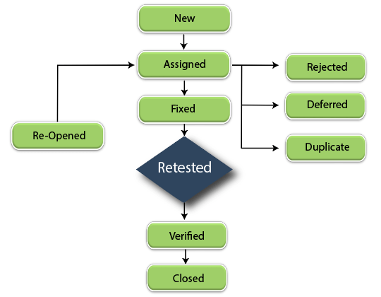
Bug Life Cycle

